Slide 1
An Overview of AI in Data Mining, and Graph Embedding
Jie Tang
Tsinghua University

Slide 2
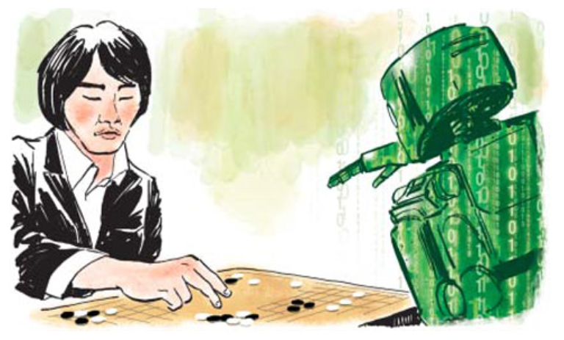
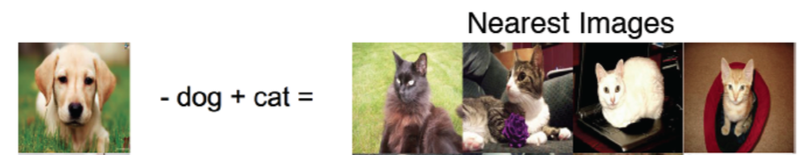
Artificial Intelligence
AlphaGo
Self-driving
Image recognition
Notes:
Why prior distribution:
To make prediction about new documents

Slide 3
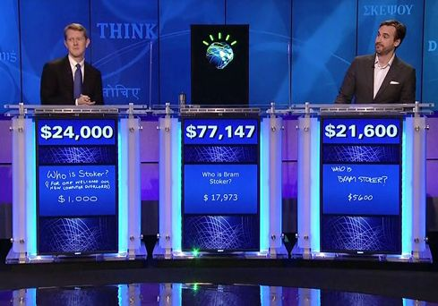
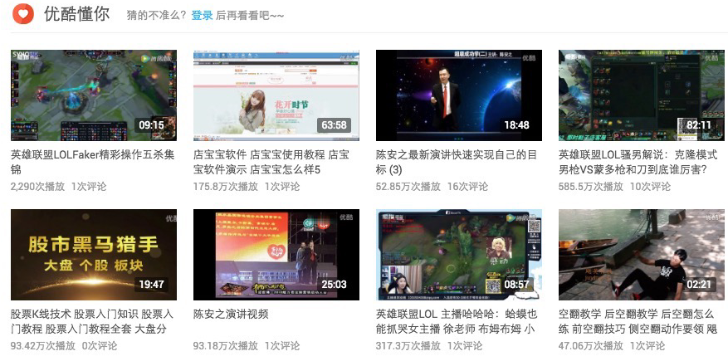
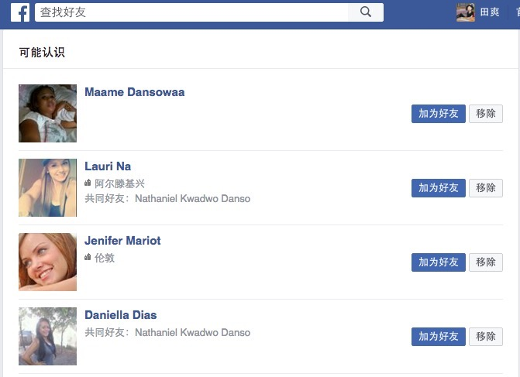

Look broader
QA
Recommendation
Social mining
Search engine
Notes:
Why prior distribution:
To make prediction about new documents

Slide 4
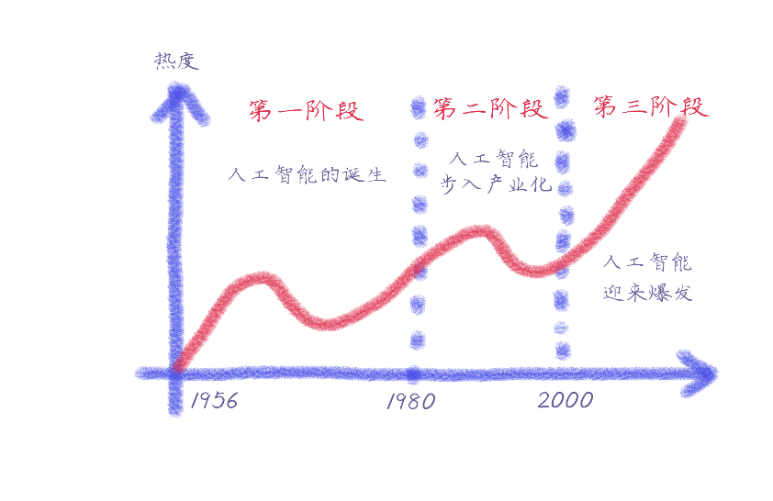
AI History
Hot degree
First
Second
Third
Logic Theory Machine
Perceptron
Expert System
Decision Tree
Big Data
Deep Learning
Notes:
“A machine ability to exhibit intelligent behavior equivalent to, or indistinguishable from, that of a human.” – Alan Turing
“machines that are capable of doing any work a man can do” – Marvin Minsky

Slide 5
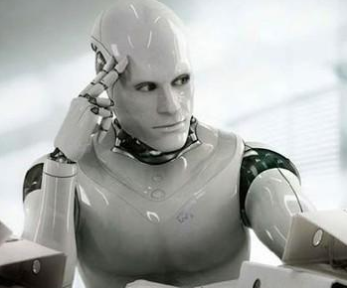
National AI Strategy
国务院印发《新一代人工智能发展规划》
“要把人工智能发展放 在国家战略层面系统布局、主动谋划，牢牢把握人工智能发展新 阶段国际竞争的战略主动，打造竞争新优势、开拓发展新空间， 有效保障国家安全。”
2017, July
AI Everything…
Intelligent Robots
AI Education
AI Agriculture
….

Slide 6
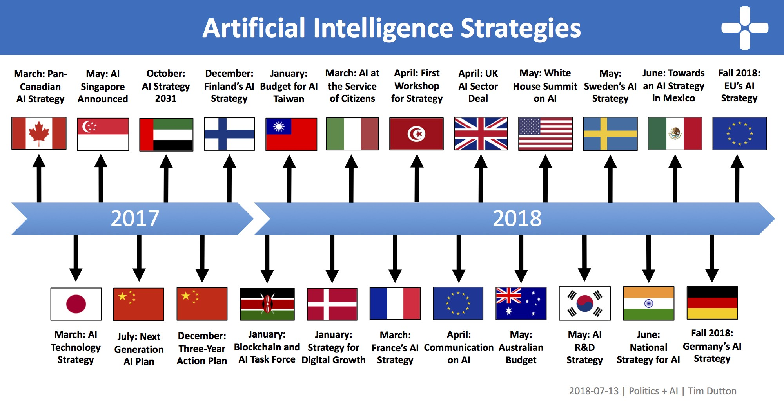
AI Strategies

Slide 7
National AI Strategies
Example Countries
In 2017, Canada launched Pan-Canadian Artificial Intelligence Strategy
AMII, Vector, Mila
This year, UK is putting AI and Data at the heart of its Industrial Strategy
In March 2018, France announces his AI strategy with investing €1.5 billion over 5 yrs on AI research and innovation
US does not have a national strategy for artificial intelligence. However,
OpenAI
TensorFlow

Slide 8
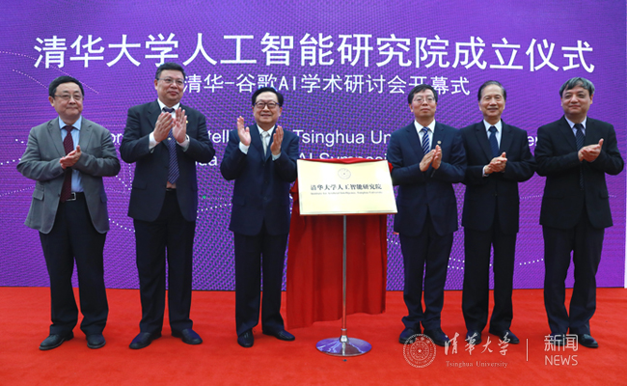
AI in Tsinghua
In September, we established Tsinghua AI Institute
By Prof. Bo Zhang
Focus
Fundamental theories and methodologies
Interdisciplinarity

Slide 9
THU Algorithm and BigData Platform
Applications
Basic AI Software
Inter-
disciplinarity
AI Algorithm Framework
Architecture
Platforms
CPU, GPU, SSD, HDD
Data and KG
KB、AMiner、Sogou
Notes:
AI三要素：算法、数据、计算力

Slide 10
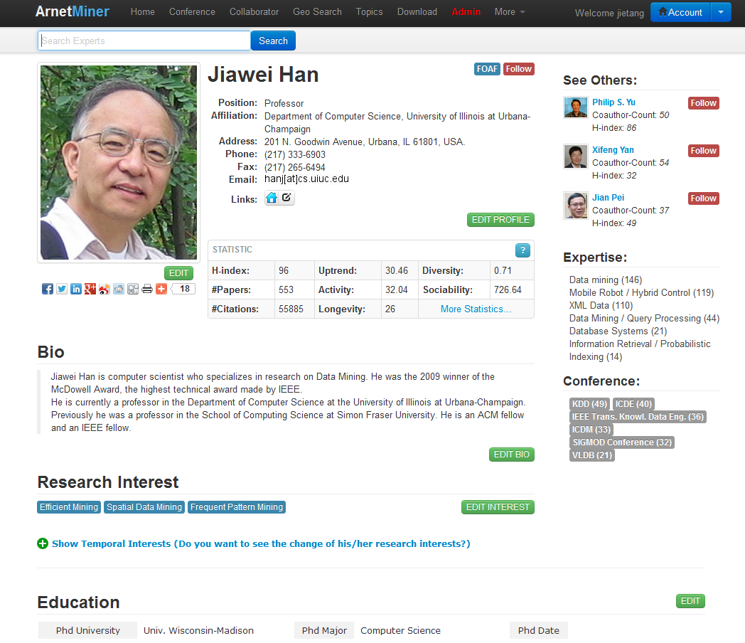
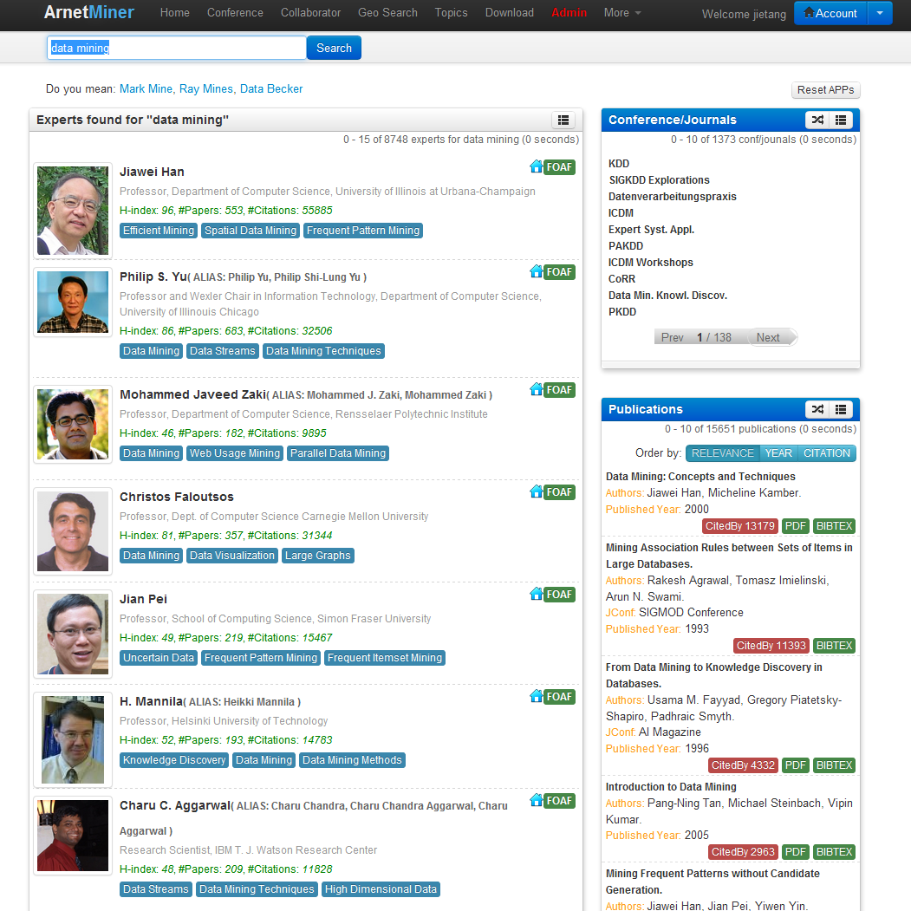
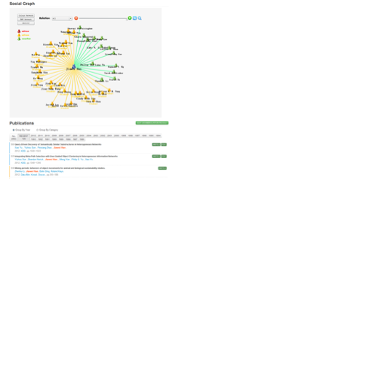
THU Algorithm and BigData Platform
Academic search and mining system —http://aminer.org
Online since 2006
>136 million researcher profiles
>201 million publication papers
>341 million requests
100K IP access from 170 countries per month
Deep analysis, mining, and search
Notes:
基于前面的理论研究成果，我们自主研发了研究者社会网络挖掘与搜索系统Arnetminer，系统从2006年开始在线运行，收集了大量的学术数据，到目前为止，系统累积2.35TB数据，有超过1.3亿次用户访问，每月就用来自170个国家的10万用户访问。

Slide 11
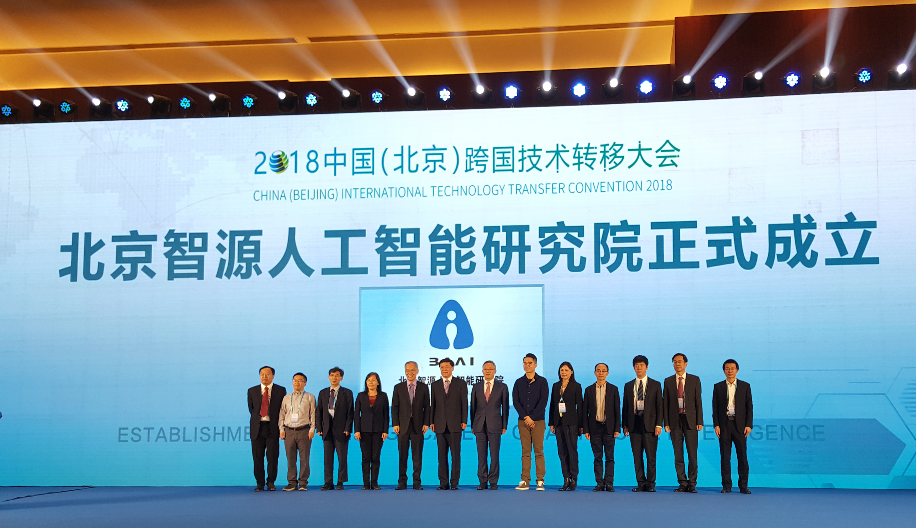
Beijing AI Institute
In November, Beijing launched Beijing AI Institute
By Dr. Hongjiang Zhang
Focus
ground-breaking research

Slide 12
AI in KDD

Slide 13
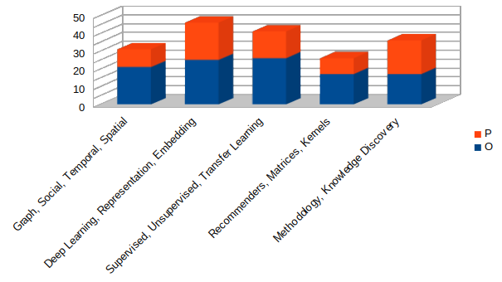
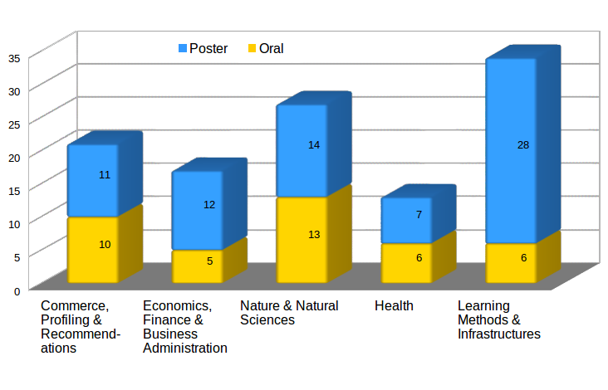
KDD 2018
• Registrations: 3,300 from 99 countries
Largest KDD ever!
• Sponsorship: US$1.2M
New Record!
• Submissions: 1480
New Record!
• Student Award US$153K
New Record!

Slide 14
Google
Q&R: A Two-Stage Approach toward Interactive Recommendation. Konstantina Christakopoulou (University of Minnesota), Alex Beutel (Google Inc), Rui Li (Google Inc), Sagar Jain (Google Inc), Ed H. Chi (Google Inc)
Collaborative Deep Metric Learning for Video Understanding. Joonseok Lee (Google AI Perception), Sami Abu-El-Haija (Google AI Perception), Balakrishnan Varadarajan (Google AI Perception), Apostol (Paul) Natsev (Google AI Perception)
Anatomy of a Privacy-Safe Large-Scale Information Extraction System Over Email. Ying Sheng (Google), Sandeep Tata (Google), James B. Wendt (Google), Jing Xie (Google), Qi Zhao (Google), Marc Najork (Google)
Scalable k-Means Clustering via Lightweight Coresets. Olivier Bachem (Google Brain & ETH Zurich), Mario Lucic (Google Brain), Andreas Krause (ETH Zurich)
Optimal Distributed Submodular Optimization via Sketching. MohammadHossein Bateni (Google), Hossein Esfandiari (Harvard University), Vahab Mirrokni (Google)
Sequences of Sets. Austin R. Benson (Cornell University), Ravi Kumar (Google), Andrew Tomkins (Google)
Modeling Task Relationships in Multi-task Learning with Multi-gate Mixture-of-Experts. Jiaqi Ma (University of Michigan, Ann Arbor), Zhe Zhao (Google Inc.), Xinyang Yi (Google Inc.), Jilin Chen (Google Inc.), Lichan Hong (Google Inc.), Ed H. Chi (Google Inc.)

Slide 15
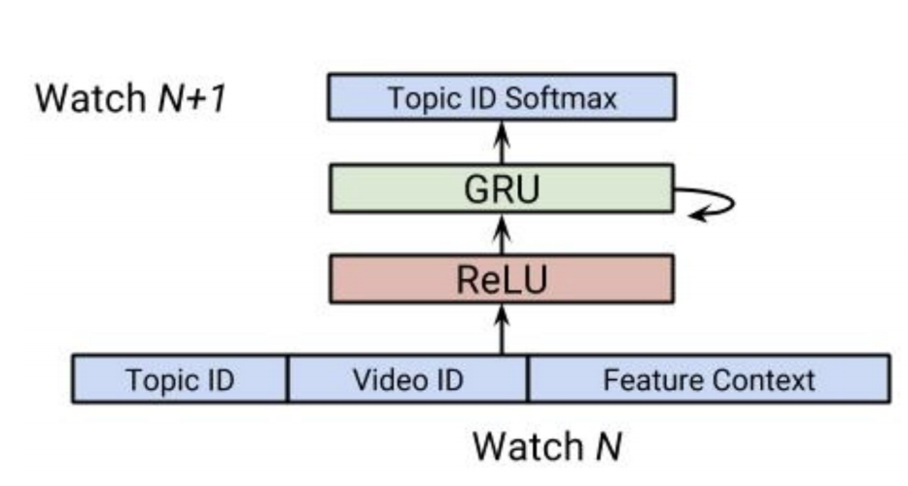
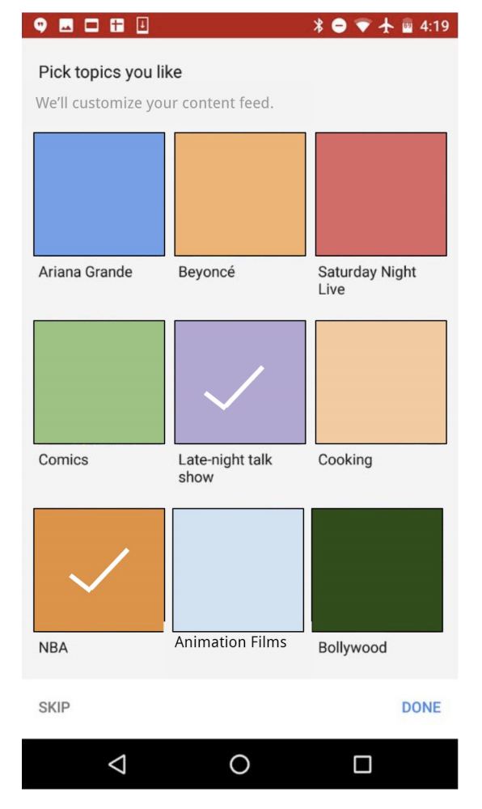
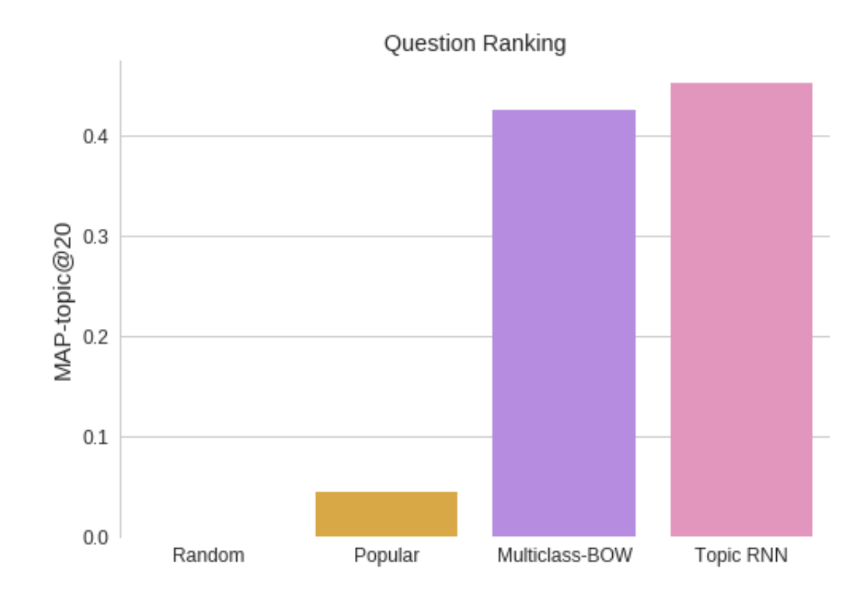
Q&R: A Two-Stage Approach toward Interactive Recommendation

Slide 16
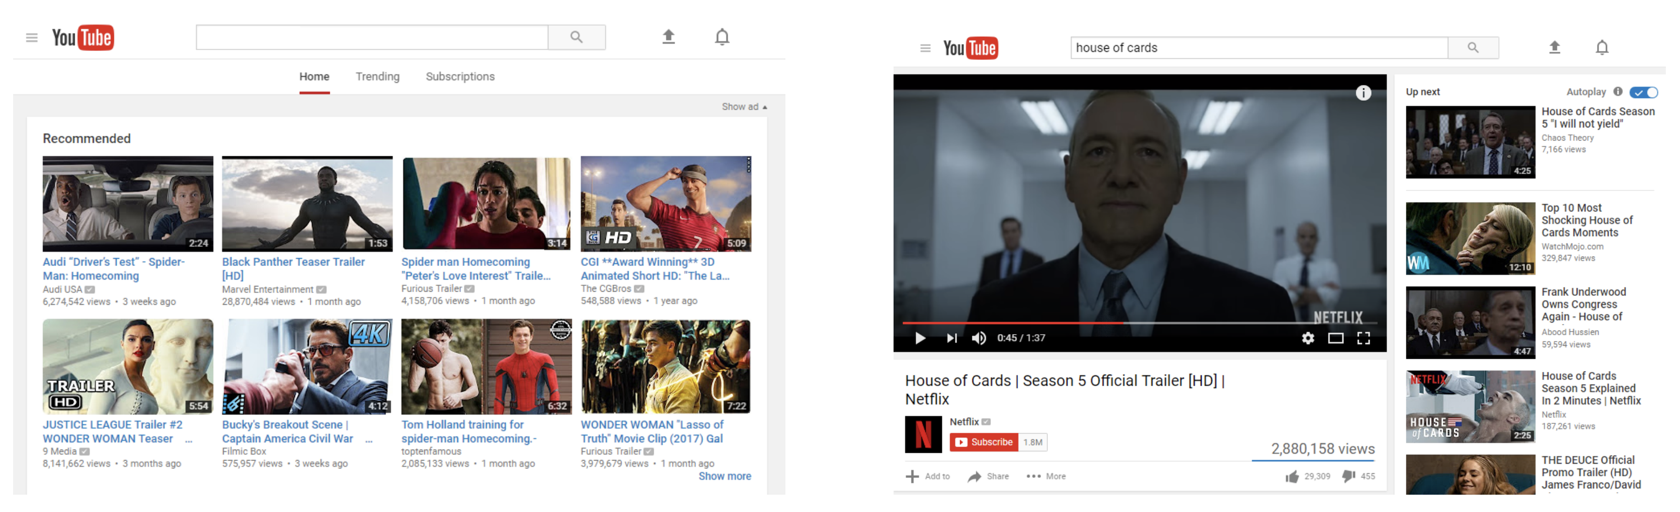
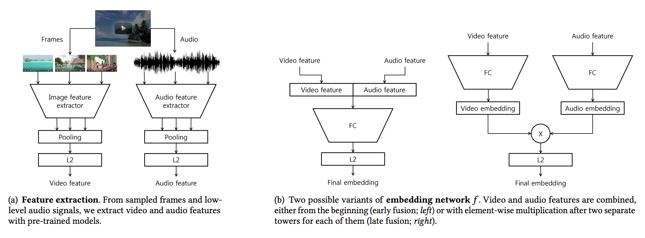
Collaborative Deep Metric Learning for Video Understanding
By Google AI Perception

Slide 17
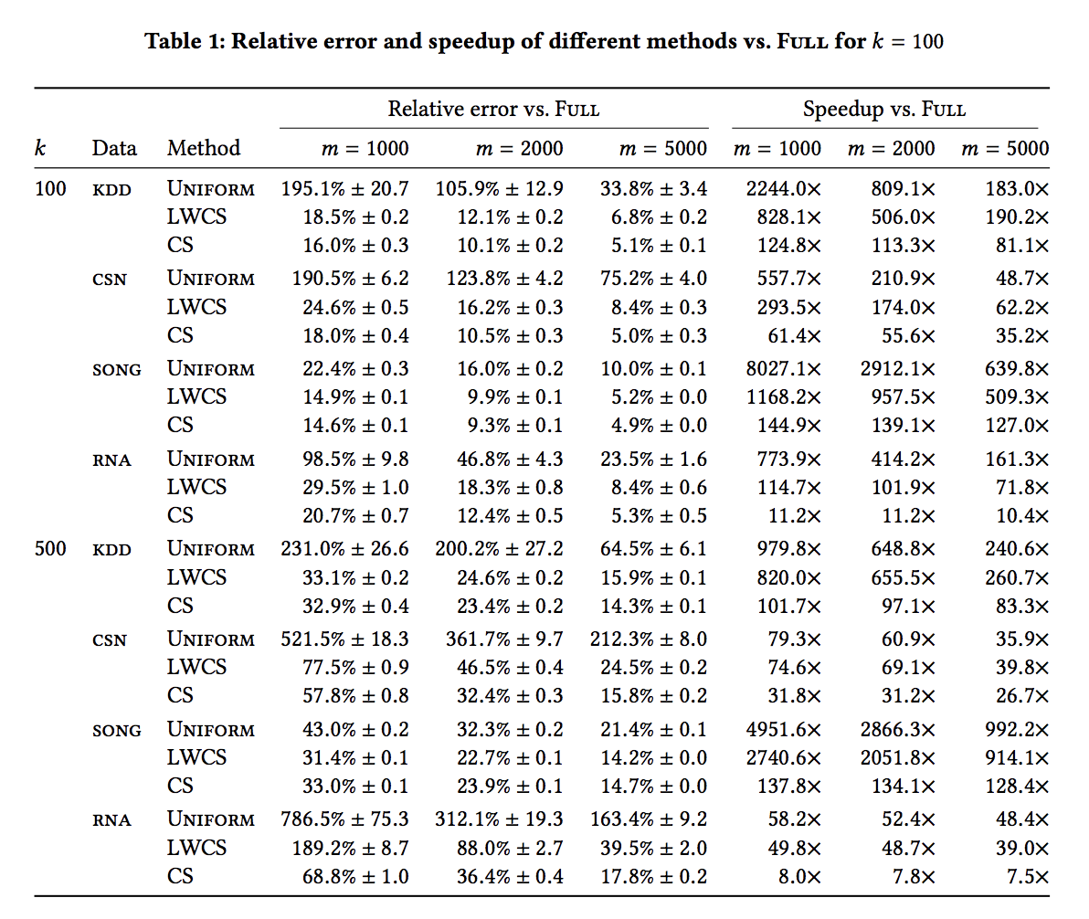
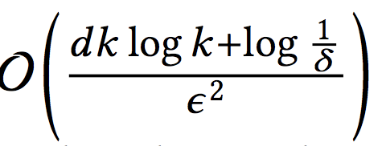
Scalable k-Means Clustering via Lightweight Coresets
By Google Brain
k-means with Coresets
Error bound

Slide 18
Amazon
Buy It Again: Modeling Repeat Purchase Recommendations. Rahul Bhagat (Amazon.com Inc.), Srevatsan Muralidharan (Amazon.com Inc.), Alex Lobzhanidze (Amazon.com Inc.), Shankar Vishwanath (Amazon.com Inc.)
OpenTag: Open Attribute Value Extraction from Product Profiles. Guineng Zheng (University of Utah), Subhabrata Mukherjee (Amazon.com), Xin Luna Dong (Amazon.com), Feifei Li (University of Utah)
Challenges and Innovations in Building a Product Knowledge Graph. Xin Luna Dong (Amazon.com)
Algorithms, Data, Hardware and Tools - a Perfect Storm. Alex Smola (Amazon Web Services)

Slide 19
Microsoft
Applying the Delta Method in Metric Analytics: A Practical Guide with Novel Ideas. Alex Deng (Microsoft Corporation), Ulf Knoblich (Microsoft Corporation), Jiannan Lu (Microsoft Corporation)
Web-Scale Responsive Visual Search at Bing. Houdong Hu (Microsoft), Yan Wang (Microsoft), Linjun Yang (Microsoft), Pavel Komlev (Microsoft), Li Huang (Microsoft), Xi (Stephen) Chen (Microsoft), Jiapei Huang (Microsoft), Ye Wu (Microsoft), Meenaz Merchant (Microsoft), Arun Sacheti (Microsoft)
BigIN4: Instant, Interactive Insight Identification for Multi-Dimensional Big Data. Qingwei Lin (Microsoft Research), Weichen Ke (Peking University), Jian-Guang Lou (Microsoft Research), Hongyu Zhang (The University of Newcastle), Kaixin Sui (Microsoft Research), Yong Xu (Microsoft Research), Ziyi Zhou (Microsoft Research), Bo Qiao (Microsoft Research), Dongmei Zhang (Microsoft Research)
RapidScorer: Fast Tree Ensemble Evaluation by Maximizing Compactness in Data Level Parallelization. Ting Ye (Microsoft), Hucheng Zhou (Alibaba Group), Will Y. Zou (Microsoft), Bin Gao (Microsoft), Ruofei Zhang (Microsoft)
Recurrent Binary Embedding for GPU-Enabled Exhaustive Retrieval from Billion-Scale Semantic Vectors. Ying Shan (Microsoft Corporation), Jian Jiao (Microsoft Corporation), Jie Zhu (Microsoft Corporation), JC Mao (Microsoft Corporation)
Efficient Attribute Recommendation with Probabilistic Guarantee. Chi Wang (Microsoft Research), Kaushik Chakrabarti (Microsoft Research)
Planet-Scale Land Cover Classification with FPGAs. Joseph Sirosh (Microsoft)

Slide 20
History of Neural Networks
Notes:
马文·明斯基
西摩·帕尔特

Slide 21
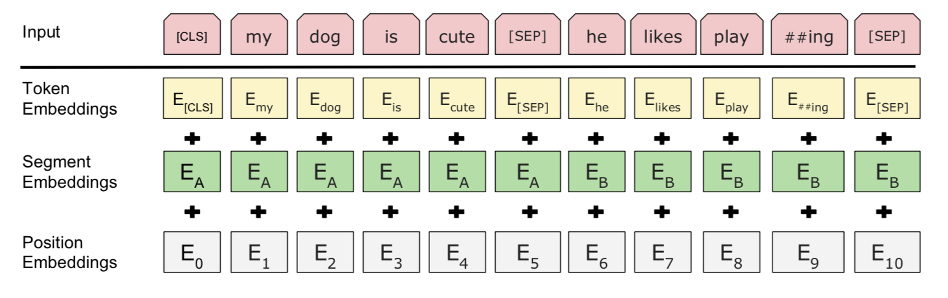
BERT
Pre-train
Fine tune
Beat all state-of-the-arts on 11 NLP tasks
https://arxiv.org/pdf/1810.04805.pdf

Slide 22
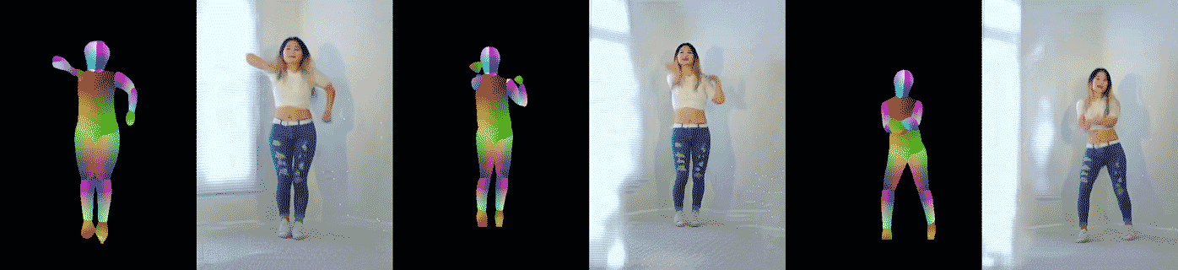
Video-to-Video Synthesis
The best video synthesis performance
https://arxiv.org/abs/1808.06601

Slide 23
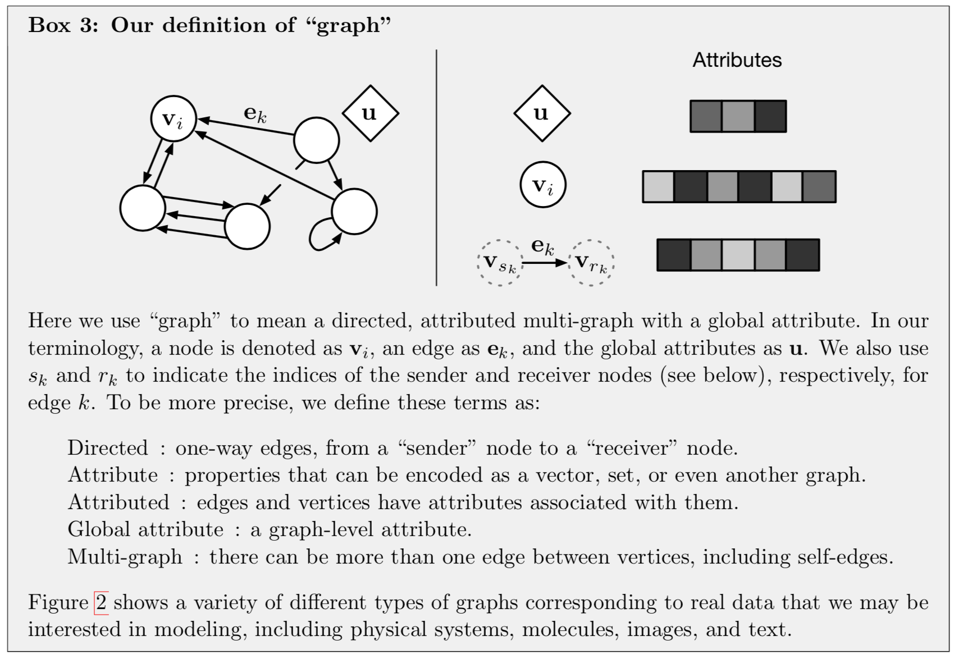
graph_net
By DeepMind
https://arxiv.org/abs/1806.01261

Slide 24
Several Our Research
Network representations learning
WSDM’18
Behavior prediction with representations
KDD’18
Learning with user feedback
NIPS’18

Slide 25


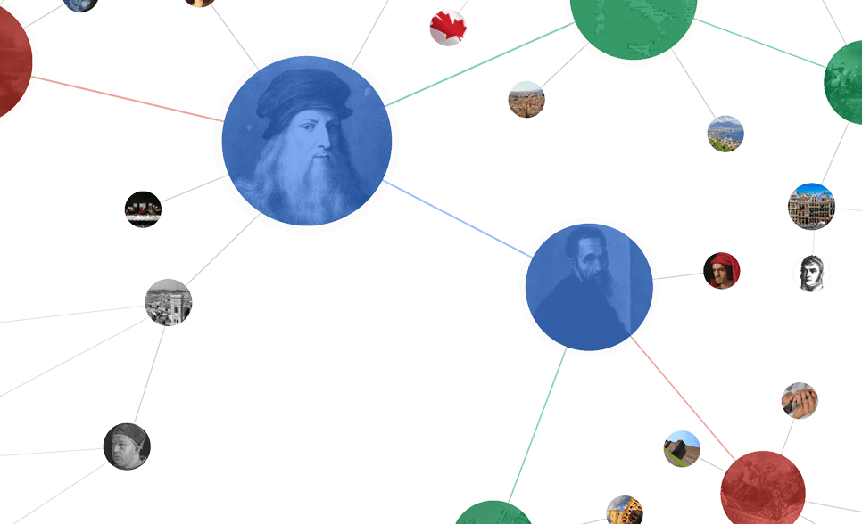
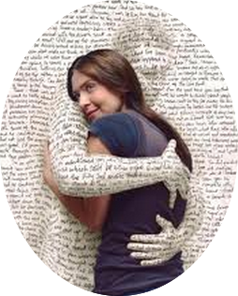



Networked World
2 billion MAU
26.4 billion minutes/day
>777 million trans. (alipay)
168.2 billion on 11/11
320 million MAU
Peak: 143K tweets/s
340 million users
influencing our daily life
700 million MAU
95 million pics/day
~200 million MAU
70 minutes/user/day
300 million MAU
30 minutes/user/day
QQ: 860 million MAU
WeChat: 960 million MAU
Notes:
http://www.digitaltrends.com/social-media/facebook-users-50-minutes/#:Tt28J4FGJlT5fA

Slide 26
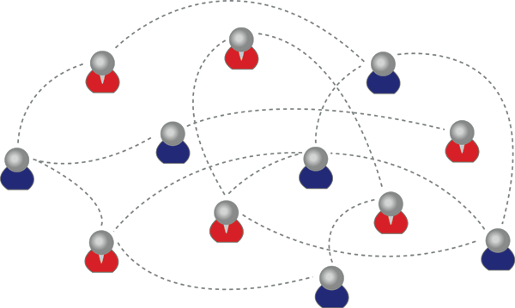
Social and Information Network
An information (or social) graph is made up of a set of individuals/entities (“nodes”) tied by interdependency (“edges”), such as friendship.
“A field is emerging that leverages the capacity to collect and analyze data at a scale that may reveal patterns of individual and group behaviors.” ^{[1]}
[1] David Lazer, Alex Pentland, Lada Adamic, Sinan Aral, Alber-Laszlo Barabasi, et al. Computational Social Science. Science 2009.

Slide 27




Roadmap—Social Network Mining
data
User
Tie
Structure
Heterogeneous
Micro
Macro
tie
Dynamic
Influence
- Behavior Pred.
- Demographics
- Social Role
- Link Prediction
- Homophily
- Social Influence
- Community
- Triad Formation
- Group Behavior
Big&Big
social
Social Theories
Graph Theories
BIG Networks

Slide 28



Representation for Networks
d-dimensional vector, d<<|V|
0.8
0.2
0.3
…
0.0
0.0
Node classification
e.g., node classification
label2
0.1
0.1
0.2
…
0.8
0.7
label1
Users with the same label are located in the d-dimensional space closer than those with different labels
Link prediction
0.4
0.6
0.3
…
0.2
0.9
Community detection

Slide 29
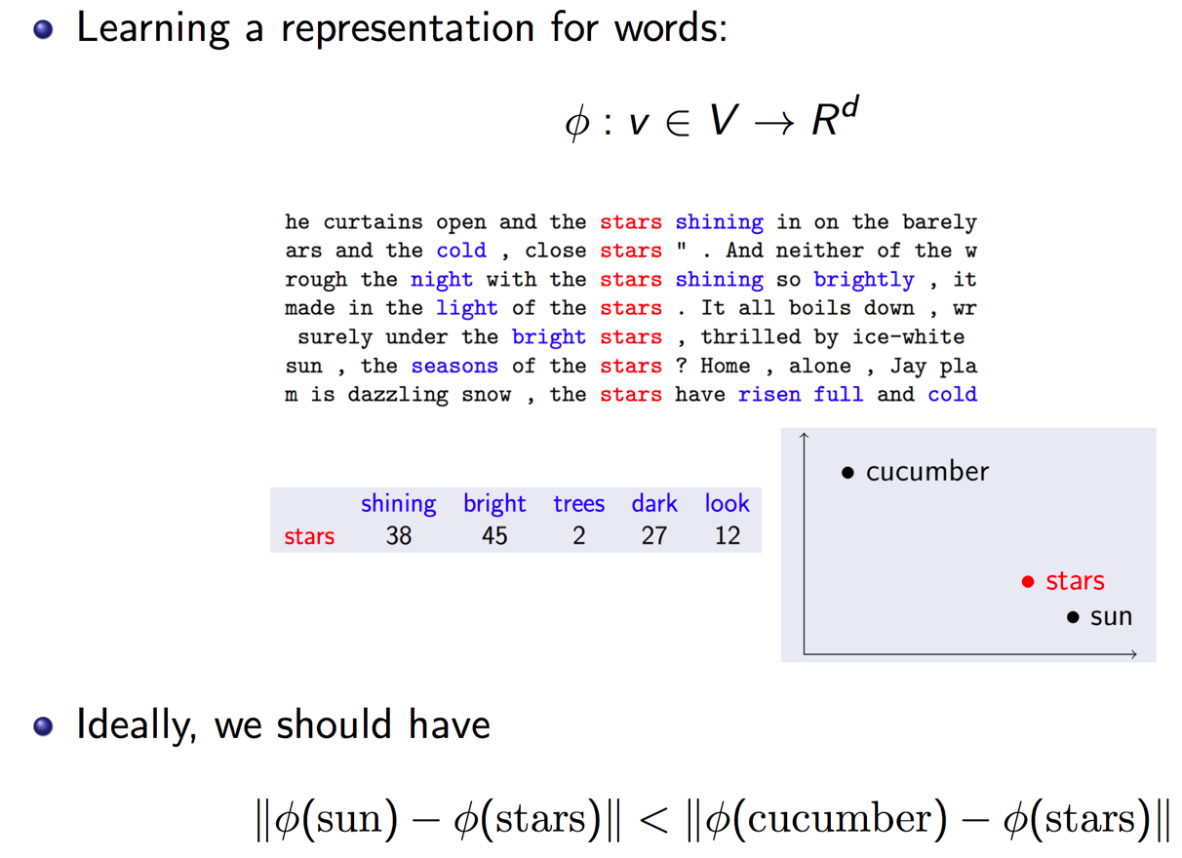
Recall word2vec for NLP

Slide 30
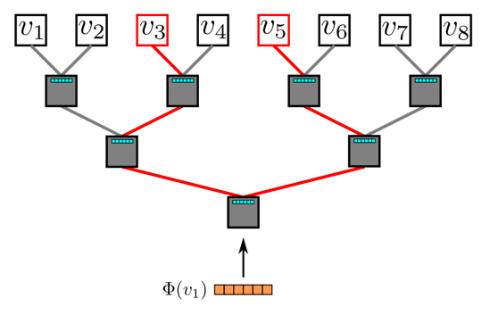
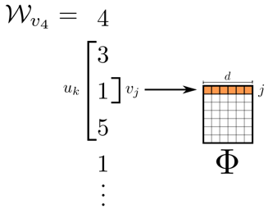
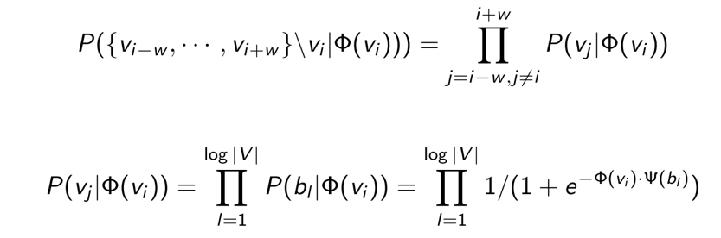
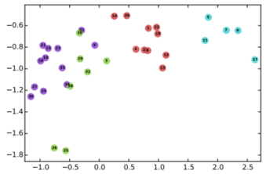
DeepWalk
Random walk
One example RW path
SkipGram with Hierarchical softmax
v₃
v₄
v₄
v₃
v₁
v₅
v₆
v₁
v₅
v₂
v₆
Hierarchical softmax
[1] B. Perozzi, R. Al-Rfou, and S. Skiena. 2014. Deepwalk: Online learning of social representations. KDD, 701–710.
[2] T. Mikolov, K. Chen, G. Corrado, and J. Dean. 2013. Efficient Estimation of Word Representations in Vector Space. CoRR abs/1301.3781
[3] T. Mikolov, I. Sutskever, K. Chen, G. Corrado, and J. Dean. 2013. Distributed Representations of Words and Phrases and their Compositionality. NIPS, 3111–3119.

Slide 31
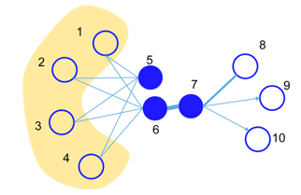
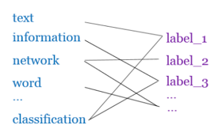
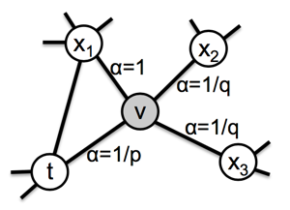
Later…
LINE^{[1]}: explicitly preserves both first-order and second-order proximities.
PTE^{[2]}: learn heterogeneous text network embedding via a semi-supervised manner.
Node2vec^{[3]}: use a biased random walk to better explore node’s neighborhood
[1] J. Tang, M. Qu, M. Wang, M. Zhang, J. Yan, and Q. Mei. 2015. Line: Large-scale information network embedding. WWW, 1067–1077.
[2] J. Tang, M. Qu, and Q. Mei. 2015. Pte: Predictive text embedding through large-scale heterogeneous text networks. KDD, 1165–1174.
[3] A. Grover and J. Leskovec. 2016. node2vec: Scalable feature learning for networks. KDD, 855–864.

Slide 32
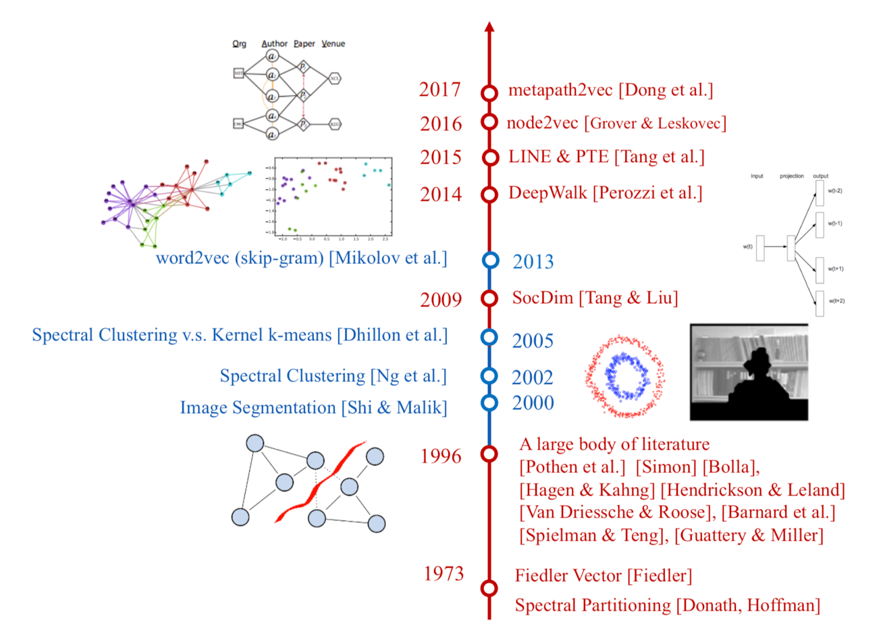
History of Network Embedding

Slide 33
Question
What are the fundamentals underlying the different models?
or
Can we unify the different network embedding approaches?

Slide 34
Preliminaries
G=(V, E) is a connected network, with |V|=n nodes and |E|=m edges
Let A be an adjacency matrix, with A_{i,j}=a_{i,j}>0 representing (i, j)∈E and a_{i,j}=0 indicating (i, j)∉E
Let D=diag(d₁, …, d_{n}) be the degree matrix, where d is the degree of node v_{i}
Define vol(G)=∑_{i}∑_{j}A_{i,j}

Slide 35
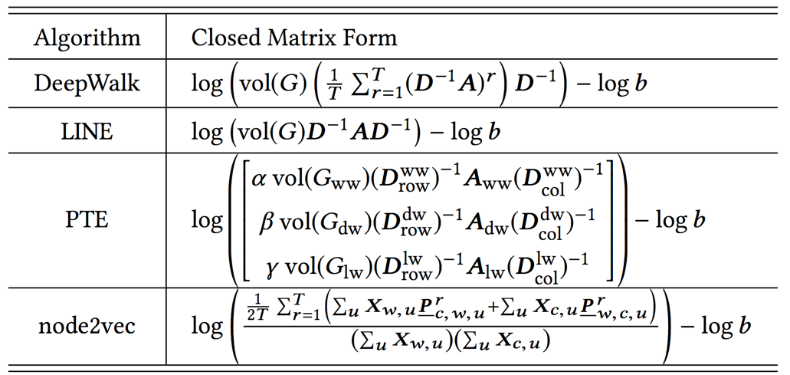
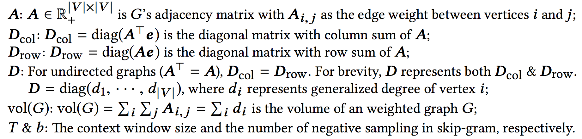
Unifying DeepWalk, LINE, PTE, and node2vec into Matrix Forms
[1] J. Qiu, Y. Dong, H. Ma, J. Li, K. Wang, and J. Tang. 2018. Network Embedding as Matrix Factorization: Unifying DeepWalk, LINE, PTE, and node2vec. WSDM’18.

Slide 36
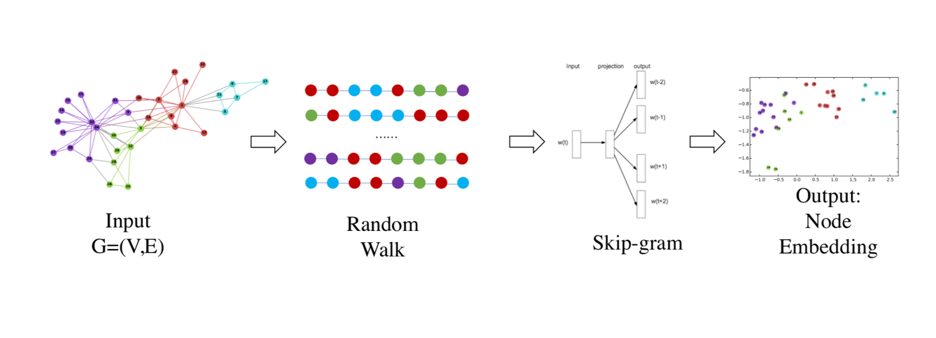
Starting with DeepWalk

Slide 37
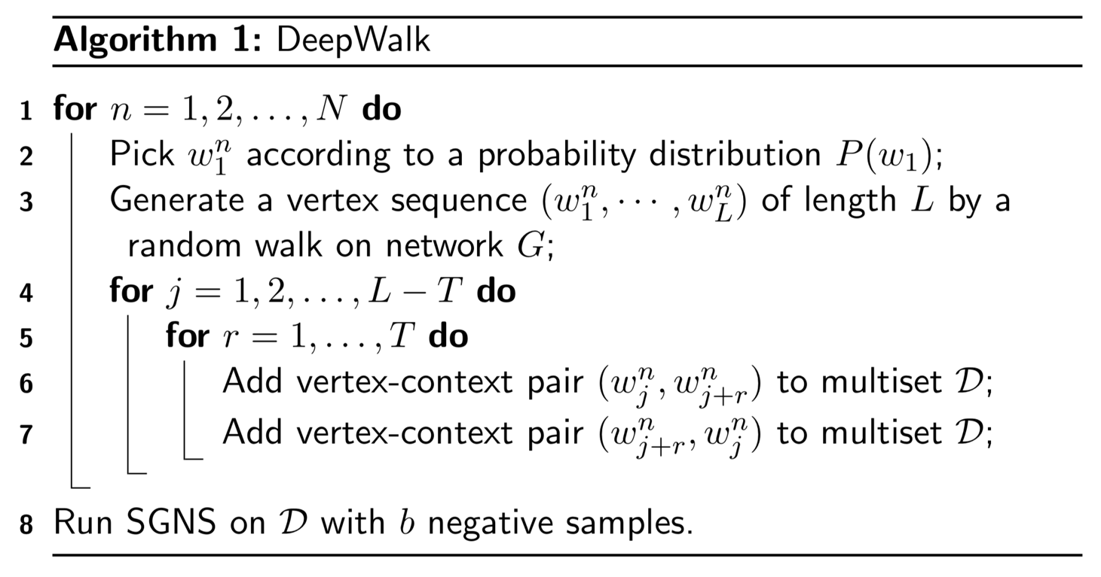
DeepWalk Algorithm

Slide 38
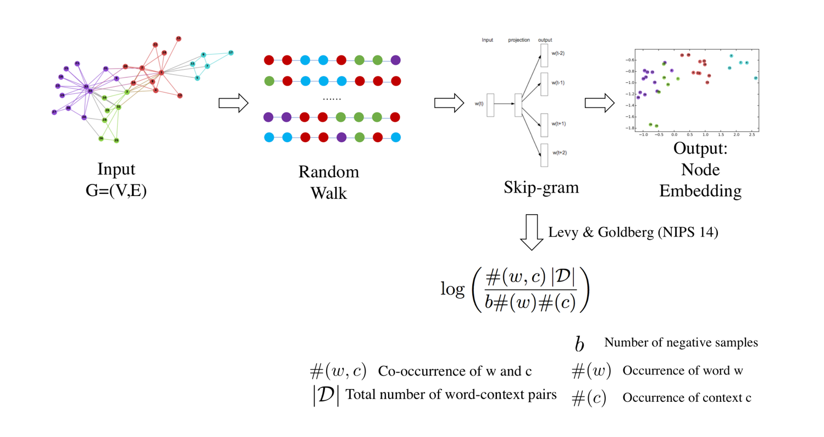
DeepWalk

Slide 39
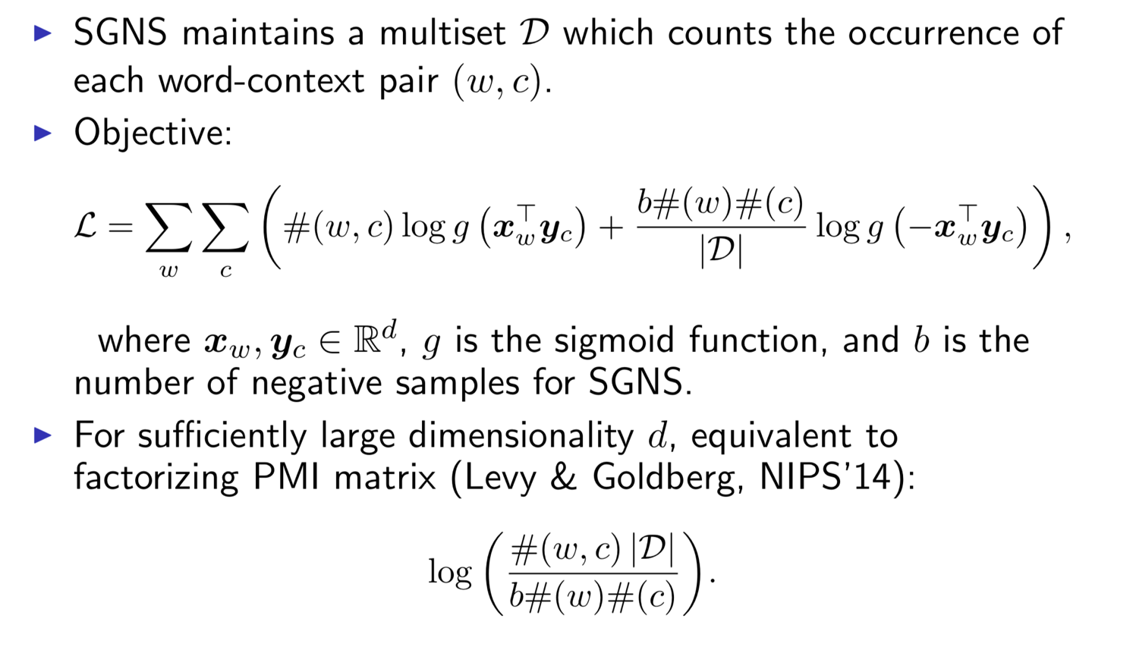
Skip-gram with Negative Sampling

Slide 40
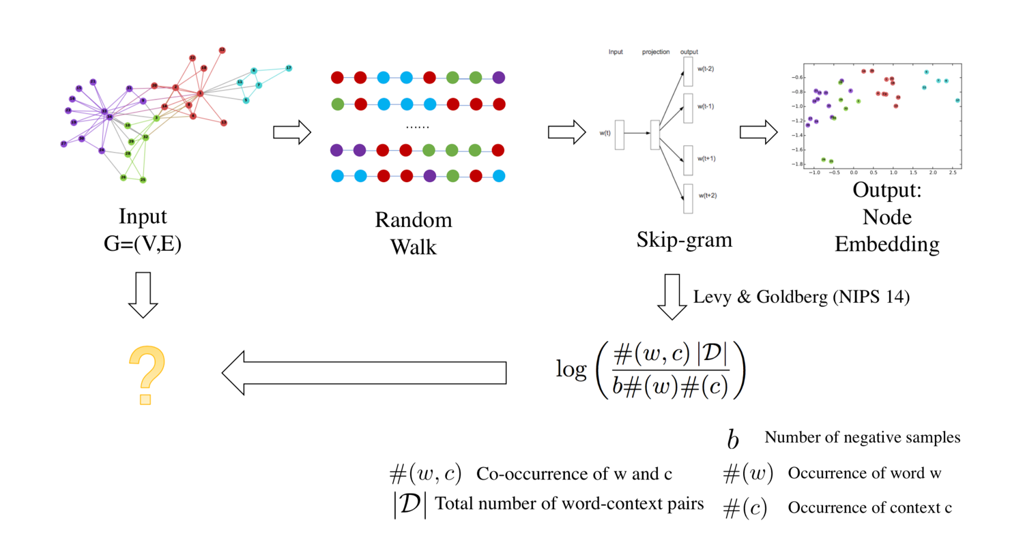
DeepWalk

Slide 41
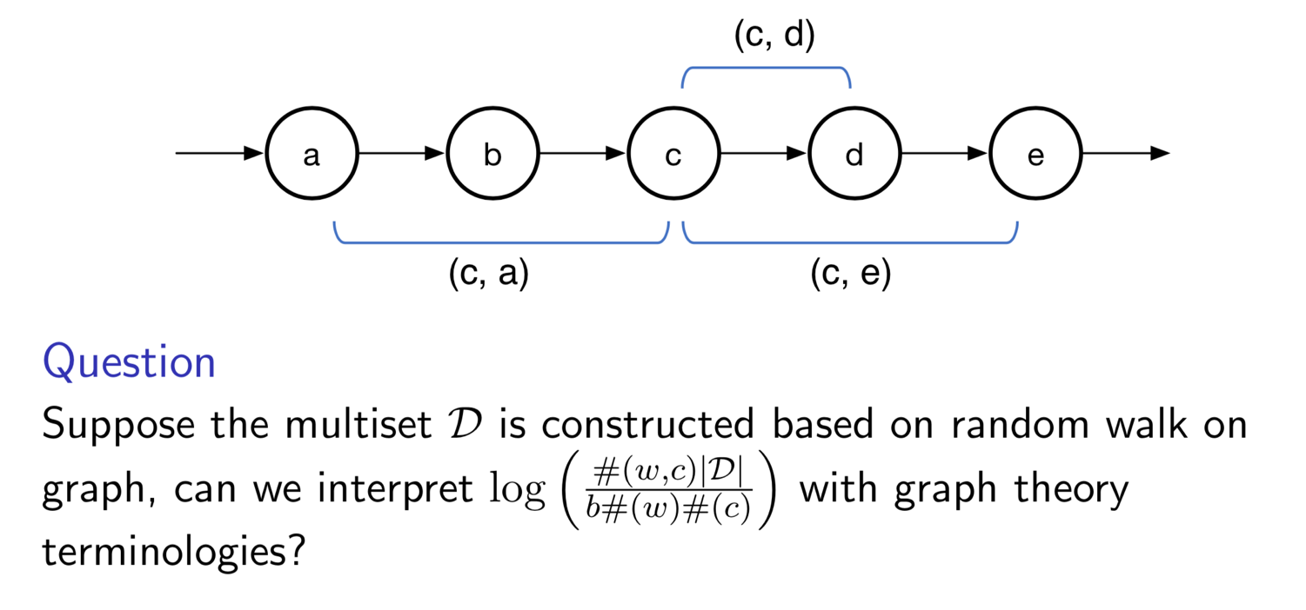
DeepWalk

Slide 42
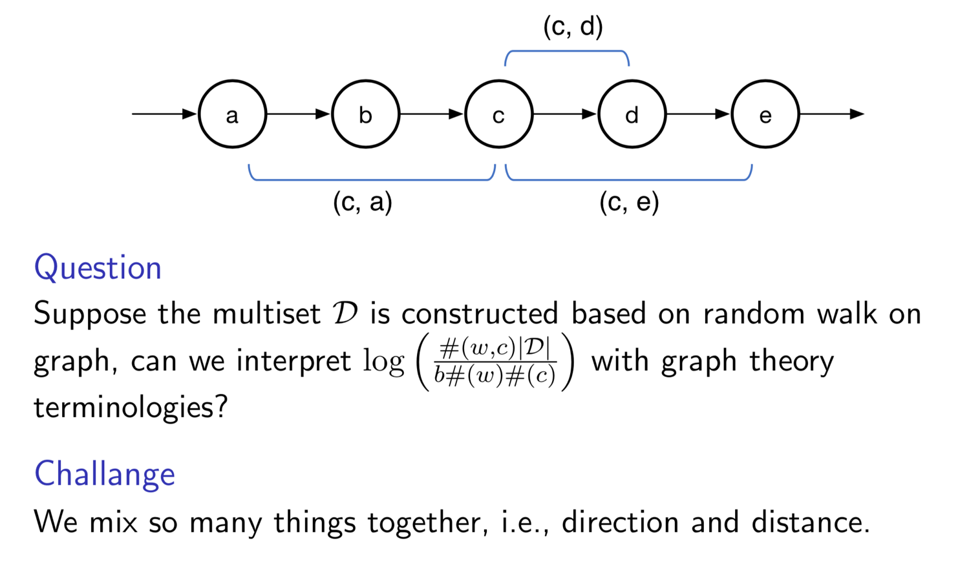
DeepWalk

Slide 43
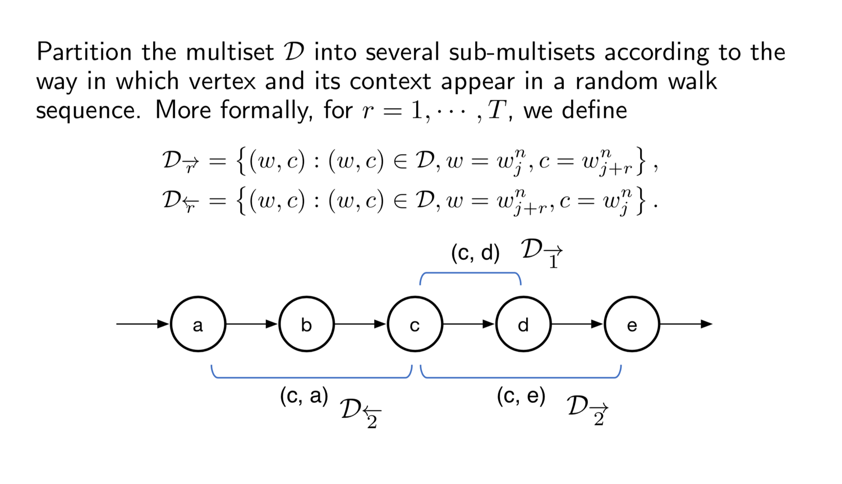
DeepWalk
Distinguish direction and distance

Slide 44
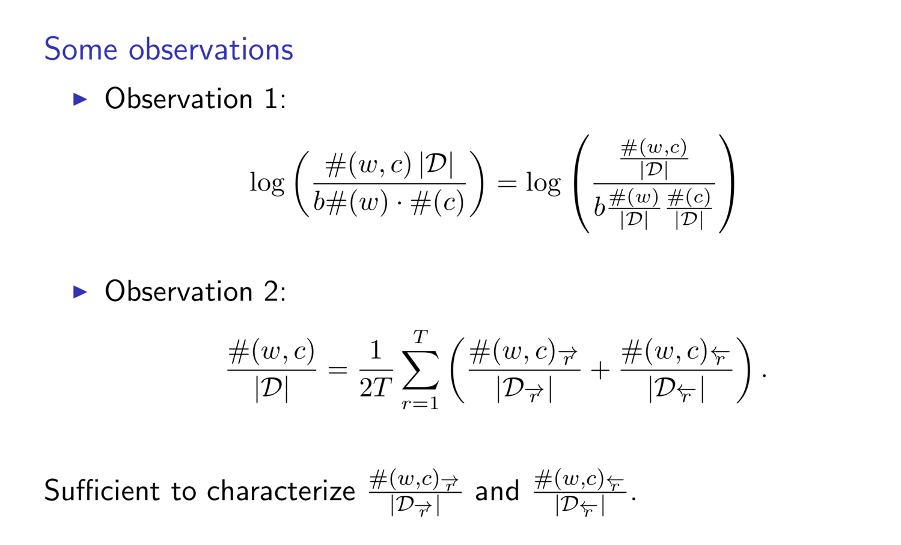
DeepWalk as Implicit Matrix Factorization

Slide 45
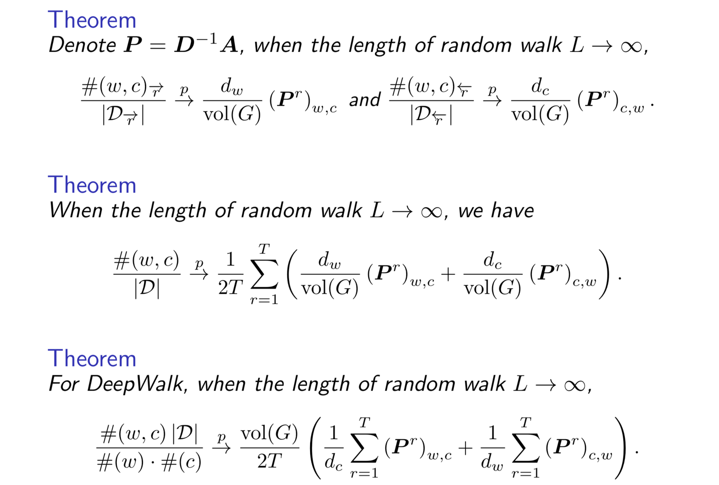
DeepWalk – Theorems

Slide 46
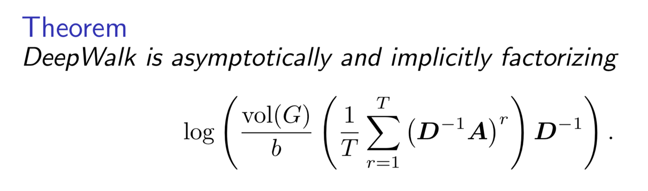
DeepWalk – Conclusion

Slide 47

DeepWalk

Slide 48

LINE

Slide 49

PTE

Slide 50

PTE as Implicit Matrix Factorization

Slide 51

node2vec — 2nd Order Random Walk

Slide 52

node2vec as Implicit Matrix Factorization

Slide 53

Unifying DeepWalk, LINE, PTE, and node2vec into Matrix Forms
[1] J. Qiu, Y. Dong, H. Ma, J. Li, K. Wang, and J. Tang. 2018. Network Embedding as Matrix Factorization: Unifying DeepWalk, LINE, PTE, and node2vec. WSDM’18.

Slide 54
Can we directly factorize the derived matrix?

Slide 55

NetMF – Network Embedding with MF

Slide 56

NetMF

Slide 57

NetMF for a Small Window Size T

Slide 58

NetMF for a Large Window Size T

Slide 59

NetMF for a Large Window Size T

Slide 60

Explicitly factorize the matrix
* approximate D^{-1/2}AD^{-1/2} with its top-h eigenpairs U_{h}𝝠_{h}U_{h}^{T}
* decompose using Arnoldi algorithm^{[1]}
* decompose using Arnoldi algorithm^{[1]}
[1] R. Lehoucq, D. Sorensen, and C.Yang. 1998. ARPACK users’ guide: solution of large-scale eigenvalue problems with implicitly restarted Arnoldi methods. SIAM.

Slide 61





Error Bound Analysis for NetMF
According to Frobenius norm’s property
and because M’_{i,j}=max(M_{i,j}, 1)>=1, we have
Also because the property of NGL,

Slide 62
Results

Slide 63

Experimental Setup
** Code available at github.com/xptree/NetMF

Slide 64

Results

Slide 65

Results
NetMF significantly outperforms LINE and DeepWalk when sparse labeled vertices are provided

Slide 66
Several Our Research
Network representations learning
Behavior prediction with representations
Learning with user feedback

Slide 67
What is Social Influence?
Social influence occurs when one's opinions, emotions, or behaviors are affected by others, intentionally or unintentionally.^{[1]}
Informational social influence: to accept information from another;
Normative social influence: to conform to the positive expectations of others.
[1] http://en.wikipedia.org/wiki/Social_influence

Slide 68
Structural Social Influence
v₁
v₂
Who are more likely to be “active”, v₁ or v₂?
e.g., active = “to attend CAAI AIDL”
Active neighbor
Inactive neighbor
v
User to be influenced

Slide 69

Structural Social Influence
Invite user to join FB by existing users
(J. Ugander, L. Backstrom, C. Marlow, and J. Kleinberg, PNAS’12)

Slide 70
Previous Solution
Hand craft features + prediction model. E.g.,
+ Logistic Regression

Slide 71
Network Representation Learning

Slide 72
Graph Attention Networks
A pre-trained network embedding layer
IN Layer to avoid overfitting
Construct feature vectors
Stacked Multi-heads GCN/GAT layers
Compare model output with ground truth

Slide 73

Experiments --- Datasets
OAG (Open Academic Graph): predict paper citations
Digg (a Reddit-like platform): predict vote-up
Twitter & Weibo: predict retweet

Slide 74

Experiments --- Results
LR/SVM: Logistic regression/Support vector machine
PSCN: SOTA deep graph kernel model (ICML’16)
DeepInf-GAT: Our solution with GAT as bulding blocks

Slide 75
Case Study
How different graph attention heads highlight different areas of the network.
Head 1: Focus on the ego-user
Head 2: Highlight active users
Head 3: Highlight inactive users

Slide 76
We applied the learned influence to help real applications —in very big networks

Slide 77
Big Data Analytics in Game Data
Online gaming is one of the largest industries on the Internet…
Facebook
250 million users play games monthly
200 games with more than 1 million active users
12% of the company’s revenue is from games
Tencent (Market Cap: ~150B $)
More than 400 million gaming users
50% of Tencent’s overall revenue is from games
[1] Zhanpeng Fang, Xinyu Zhou, Jie Tang, Wei Shao, A.C.M. Fong, Longjun Sun, Ying Ding, Ling Zhou, and Jarder Luo. Modeling Paying Behavior in Online Social Networks. CIKM'14.

Slide 78


Two games: DNF
Dungeon & Fighter Online (DNF)
A game of melee combat between users and large number of underpowered enemies
400+ million users, the 2nd largest online game in China
Users in the game can fight against enemies by individuals or by groups

Slide 79


Two games: QQ Speed
QQ Speed
A racing game that users can partake in competitions to play against other users
200+ million users
Users can race against other users by individuals or forma a group to race together
Some users may pay…

Slide 80
Task
Given behavior log data and paying logs of online game users, build a model to help
Will social influence play an important role in this task?
item recommendation

Slide 81


Online Test
Test setting
Two groups: test group and control group
Send msgs to invite the user to attend a promotion activity.
test group2
control group

Slide 82
Dropout Prediction
Dropout prediction with influence
Problem: Call back of users
Game data: King of Glory (王者荣耀)
 | With Influence |  |  | w/o influence
Top k | #message | #success | ratio | #message | #success | ratio
1 | 3996761 | 1953709 | 48.88% | 6617662 | 2732167 | 41.29%
2 | 2567279 | 1272037 | 49.55% | 9756330 | 4116895 | 42.20%
3 | 1449256 | 727728 | 50.21% | 10537994 | 4474236 | 42.46%
4 | 767239 | 389588 | 50.78% | 9891868 | 4255347 | 43.02%
5 | 3997251 | 2024859 | 50.66% | 15695743 | 6589022 | 41.98%

Slide 83
Dropout Prediction
Deployed to 9 Games
王者荣耀
欢乐斗地主
QQ飞车手游
穿越火线手游龙之谷
英雄联盟
逆战
NBA
CF
In 2017, the total #callback: 129,000,000
In 2018, up to now, the number is 52,890,000

Slide 84
Several Our Research
Network representations learning
Behavior prediction with representations
Learning with user feedback

Slide 85


XiaoMU(“小木”) on XuetangX

Slide 86

One example of intervention: active question
Question: What are the shortcomings of Raven Progressive Test? (3 users thumbs up)
Fundamental Challenges (3W):
When
to Whom
ask What (question)

Slide 87
Preliminary study—first version
Question: What are the shortcomings of Raven Progressive Test?

Slide 88
Bandit Learning with Implicit Feedback
[1] Yi Qi, Qingyun Wu, Hongning Wang, Jie Tang, and Maosong Sun. Bandit Learning with Implicit Feedback. NIPS'18.

Slide 89
Bandit (Online) Learning
An online learning framework: contextual bandit
Click/Buy etc. as reward, features of content/user/etc. as context.
Adaptively and sequentially learning
Successfully deployed for recommender system and ad displaying.
The problem is about the definition of rewards
Is non-click indicates negative impression?
Examination hypothesis:
Click occurs if and only if examination happens
Implication: no-click DOES NOT necessarily mean negative feedback

Slide 90




Model
Classical bandit model with linear reward:
Reward is 1 if clicked, 0 if non-clicked.
Inevitably linear regret.
Our model: E-C bandit (Examination-click bandit)
Thus:
The common goal: regret minimization

Slide 91
Model
E-C bandit
A generative model of click, explicitly incorporating examination;
Examination as a binary variable, is by nature NOT observable, thus a latent variable;
The essential problem
Is it possible to learn E-C bandit under online learning’s paradigm?
Regret analysis affirms learnability to some extent.
How to learning E-C bandit on the fly?
Variational approximation together with Thompson sampling

Slide 92


Algorithm– Parameter Estimation
The Log-likelihood of one sample:
The variational lower bound:
Jensen’s inequality for log-sum;
2-degree polynomial lower bound of log-logistic function;
Thus, a lower bound in the form of 2-degree polynomial, which leads to an approximate Gaussian posterior when given a Gaussian prior and allows for O(1) update.

Slide 93
Algorithm – Decision Making
Thompson sampling:
Choose any arm by its probability of being the best among the candidate;
Easy to implement and well integrated with our estimation procedure (Recall we have approximate Gaussian posterior of the parameters).

Slide 94


Algorithm

Slide 95
Regret Analysis
Sublinear regret is guaranteed if:
MLE estimate(i.e., log-loss estimate in our 0-1 reward case) is accurate;
Thompson sampling samples from the true posterior.
See detailed proof in the paper and appendix.
Proof’s framework is the same as Russo,2014. Key proposition: aggregated empirical discrepancy is bounded within a sub-linear increasing ellipse w.h.p.(Proposition 1 in the paper.)
By experiment we demonstrate the approximation is tight, and result improving.

Slide 96

Evaluation - Simulation

Slide 97

Evaluation – Empirical data

Slide 98
Summary
Network representations learning
WSDM’18
Behavior prediction with representations
KDD’18
Learning with user feedback
NIPS’18

Slide 99

AI Future Trend
From perceptron to cognition
Storage & Computing
Recognize text, images, objects, voices
Organize and generate knowledge, reasoning
Computing
Perception
Cognition

Slide 100

Machine Learning Trend
x_{new}
Training data {(x_{i},y_{i})}
Learning algorithm
f
Predicted y
Big Data
Deep Learning
Collective Learning

Slide 101
Representative Publications
Yi Qi, Qingyun Wu, Hongning Wang, Jie Tang, and Maosong Sun. Bandit Learning with Implicit Feedback. NIPS'18.
Jiezhong Qiu, Jian Tang, Hao Ma, Yuxiao Dong, Kuansan Wang, and Jie Tang. DeepInf: Modeling Influence Locality in Large Social Networks. In KDD’18.
Yutao Zhang, Fanjin Zhang, Peiran Yao, and Jie Tang. Name Disambiguation in AMiner: Clustering, Maintenance, and Human in the Loop. In KDD’18.
Golnoosh Farnadi, Jie Tang, Martine De Cock, and Marie-Francine Moens. User Profiling through Deep Multimodal Fusion. In WSDM'18.
Jiezhong Qiu, Yuxiao Dong, Hao Ma, Jian Li, Kuansan Wang, and Jie Tang. Network Embedding as Matrix Factorization: Unifying DeepWalk, LINE, PTE, and node2vec. In WSDM'18.
Yutao Zhang, Robert Chen, Jie Tang, Jimeng Sun, and Walter Stewart. LEAP: Learning to Prescribe Effective and Safe Treatment Combinations for Multimorbidity. In KDD'17, pages 1315-1324.
Jie Tang, A.C.M. Fong, Bo Wang, and Jing Zhang. A Unified Probabilistic Framework for Name Disambiguation in Digital Library. IEEE Transaction on Knowledge and Data Engineering (TKDE), 2012, Volume 24, Issue 6, Pages 975-987.
Jie Tang, Tiancheng Lou, Jon Kleinberg, and Sen Wu. Transfer Learning to Infer Social Ties across Heterogeneous Networks. ACM Transactions on Information Systems (TOIS), 2016, Volume 34, Issue 2, Article No. 7.
Jie Tang, Jing Zhang, Limin Yao, Juanzi Li, Li Zhang, and Zhong Su. ArnetMiner: Extraction and Mining of Academic Social Networks. In KDD‘08, pages 990-998.
Jie Tang, Jimeng Sun, Chi Wang, and Zi Yang. Social Influence Analysis in Large-scale Networks. In KDD‘09, pages 807-816.
Chi Wang, Jiawei Han, Yuntao Jia, Jie Tang, Duo Zhang, Yintao Yu, and Jingyi Guo. Mining Advisor-Advisee Relationships from Research Publication Networks. In KDD‘10, pages 203-212.
Chenhao Tan, Lillian Lee, Jie Tang, Long Jiang, Ming Zhou, and Ping Li. User-level sentiment analysis incorporating social networks. In KDD‘11, pages 1397-1405.
Jie Tang, Sen Wu, Jimeng Sun, and Hang Su. Cross-domain Collaboration Recommendation. In KDD‘12, pages 1285-1293. (Full Presentation & Best Poster Award)
Jie Tang, Sen Wu, and Jimeng Sun. Confluence: Conformity Influence in Large Social Networks. In KDD‘13, pages 347-355.
Yuxiao Dong, Yang Yang, Jie Tang, Yang Yang, and Nitesh V. Chawla. Inferring User Demographics and Social Strategies in Mobile Social Networks. In KDD‘14, pages 15-24.

Slide 102
Thank you！
Collaborators: John Hopcroft, Jon Kleinberg, Chenhao Tan (Cornell)
Yuxiao Dong, Hao Ma, Kuansan Wang (MSR)
Hongning Wang (Virginia U)
Jiezhong Qiu, Yi Qi, Zhanpeng Fang, Chenhui Zhang (THU)
Jie Tang, KEG, Tsinghua U, http://keg.cs.tsinghua.edu.cn/jietang
Download all data & Codes, http://arnetminer.org/data http://arnetminer.org/data-sna

Slide 103


Slide 104


Slide 105


Slide 106
人工智能 大数据与人工智能 关键技术与产业 发展机遇与挑战
目录

Slide 107


发展机遇（一）
大数据时代为人工智能提供了海量的数据资源
目前全球数据总量每年以倍增的速度增长，中国数据量占全球数据总量的近20%

Slide 108

发展机遇（二）
深度学习、脑科学等新理论新技术提供了方法创新

Slide 109

发展机遇（三）
学科领域交叉与渗透

Slide 110
大数据与人工智能（一）
大数据智能理论
数据驱动与知识引导相结合的人工智能新方法
以自然语言理解和图像图形为核心的认知计算理论
综合深度推理与创意人工智能理论与方法
非完全信息下智能决策基础理论与框架
数据驱动的通用人工智能数学模型与理论
人工智能基础数据平台
建设面向人工智能的公共数据资源库、标准测试数据集、云服务平台

Slide 111
大数据与人工智能（二）
大数据人工智能开源软件基础平台
基于大数据建立人工智能开源软硬件基础平台
重点建设支持知识推理、概率统计、深度学习等人工智能范式的统一计算框架
构建人工智能软件、硬件和智能云之间相互协同的生态链
大数据智能化服务平台
具备从大数据到知识、从知识到决策的能力

Slide 112
共性关键技术
知识计算引擎与知识服务技术
跨媒体分析推理技术
自然语言处理技术
自主无人系统
虚拟现实智能建模
群体智能关键技术
智能计算芯片与系统
混合增强智能新技术

Slide 113
关键新兴产业
自主无人系统
自主无人系统计算架构
复杂动态场景感知与理解
面向复杂环境的适应性智能导航
虚拟现实智能建模
智能对象建模的技术与方法
虚拟对象智能行为的数学表达与建模方法
虚拟对象与虚拟环境和用户之间的深入交互

Slide 114

人工智能领域分类

Slide 115
National AI Strategy
Date | 发布机构 | 政策名称
2015年9月 | 国务院 | 《促进大数据发展行动纲要》
2016年5月 | 发改委、科技部、工信部、网信办 | 《“互联网+”人工智能三年行动实施方案》
2017年1月 | 工信部 | 《大数据产业发展规划（2016－2020年）》
2017年7月 | 国务院 | 《新一代人工智能发展规划》
2017年12月 | 工信部 | 《促进新一代人工智能产业发展三年行动计划（2018－2020年）》

Slide 116
国务院印发《新一代人工智能发展规划》

Slide 117
大数据发展目标
资源共享开放
大力推动政府部门数据共享
稳步推动公共数据资源开放
统筹规划大数据基础设施建设
加快民生服务普惠化
公共服务大数据工程
医疗健康服务大数据
社会保障服务大数据
教育文化大数据
交通旅游服务大数据

Slide 118
人工智能发展规划
打造人工智能基础资源与创新平台，人工智能产业体系、创新服务系、标准化体系基本建立
人工智能基础理论实现重大突破、技术与应用部分达到世界领先水平
2018
2020
2020
2025
人工智能总体技术和应用与世界先进水平同步
人工智能理论、技术与应用总体达到世界领先水平，成为世界主要人工智能创新中心

Slide 119
人工智能发展现状
人工智能目前主要应用于智能助理、自动驾驶、医疗健康、电商、金融等领域
应用领域 | 代表企业 | 应用
智能助理 | 亚马逊、Google | 智能手机语音助手、陪护机器人
自动驾驶 | Google、Uber、特斯拉、亚马逊 | 智能汽车、公共交通、快递用车
医疗健康 | Enlitic、Intuitive Surgical | 医疗健康监测诊断、智能医疗设备、医疗机器人
电商领域 | 亚马逊、梅西百货 | 仓储物流、智能导购和客服
金融领域 | Welthfront、Kensol、Promontory | 智能投顾、金融监管

Slide 120


Slide 121

AI开放平台
部分国际AI开放平台
OpenAI (Sutskever)
Mila (Bengio)
Vector Institute (Hinton)

Slide 122
OpenAI
Research Director: Ilya Sutskever
Sponsored by
马斯克
Y Combinator总裁阿尔特曼
天使投资人彼得•泰尔等
目标：制造通用机器人和使用自然语言的聊天机器人
2年来重要成果
创建了一个名为 Universe 的软件平台
他们创造了AI游戏玩家，在Dota2中击败 99.95％玩家
建立了能完成日本相扑摔跤或者踢足球的虚拟机器人
Notes:
用于测量和训练全球各地的人工智能系统。它旨在让机器人学习不同的策略

Slide 123
Mila (Bengio)
Founder: Yoshua Bengio
以人为本的AI平台
培养年轻人
专注Deep Learning
创新创业

Slide 124

Vector Institute (Hinton)
Founder: Geoffrey Hinton
以研究为主
专注Deep Learning
创新创业

Slide 125


感知智能现有进展
声音识别：
利用OpenCL实现基FPGA平台的语音识别系统，常用场景下准确率已达到98%
人脸识别：
标准金融验证场景目前已经达到误识率十万分之一以下，通过率超过97%；
典型公司：Google、Nuance、讯飞
典型公司：Google、旷视Face++、Facebook
Notes:
Why prior distribution:
To make prediction about new documents

Slide 126



算法是核心，计算、数据是基础
人工智能的核心：算法
算法
基础条件：计算和数据
计算能力
数据
实现核心：机器通过算法实现人工智能
现状：使用GPU并行计算神经网络
作用：提升运算速度，降低计算成本
未来：量子计算、速度更快的芯片
现状：互联网发展积累了一定数据
作用：训练机器，提升算法性能
未来：物联网发展带来环境、行为等全面数据
突破方向：认知智能是下一个突破方向
突破途径：人工智能突破主要通过算法性能的提升，主要有工程学法和模拟法
方法一：工程学方法
（Engineering Approach）
采用传统的编程技术，利用大量数据处理经验改进提升算法性能。
方法二：模拟法
（Modeling Approach）
模仿人类或其他生物所用的方法或机理，提升算法性能，例如遗传算法和神经网络。
应用驱动、算法分析为核心、数据/计算为基础
Notes:
Why prior distribution:
To make prediction about new documents

